Slide 1
RAM Chip(Memory)
Random Access Memory (RAM)
    Initially contains no data
    Digital circuit can retrieve and store data at various locations on a RAM chip
    Data pins are bidirectional (into or out of the chip)
    Volatile: loses data when power is removed

Slide 2
RAM
static RAM (SRAM).
  cells take more space; cannot be made as dense as DRAM
  result: SRAM is more expensive than DRAM
  used where high speed is necessary (e.g., cache)
  The contents stay valid and does not have to be refreshed.
dynamic RAM (DRAM)
  Leaky capacitors. DRAM needs to be refreshed after several milliseconds
  results in longer cycle time, the minimum time between consecutive memory accesses
  simpler internally
  Cheaper. Used for Computer Primary memory
normally DRAM is a generation ahead of SRAM in terms of size

Slide 3
Memory
Reading a memory:
  place address code of the desired locations on the address pins of the RAMs/ROMs
  internal circuit must read address and enable the correct bit cells
  places contents of the locations on the output lines
  Each RAM chip has 2^n * m bit cells. n address inputs and m bidirectional data pins
The following slides give details of the above read process for DRAM chip

Slide 4
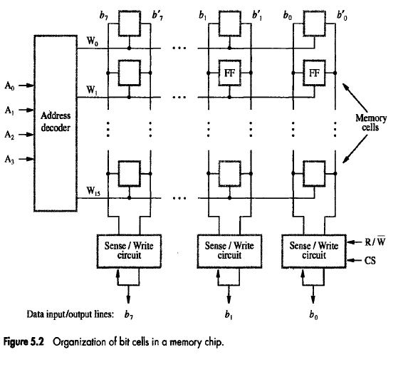

Slide 5
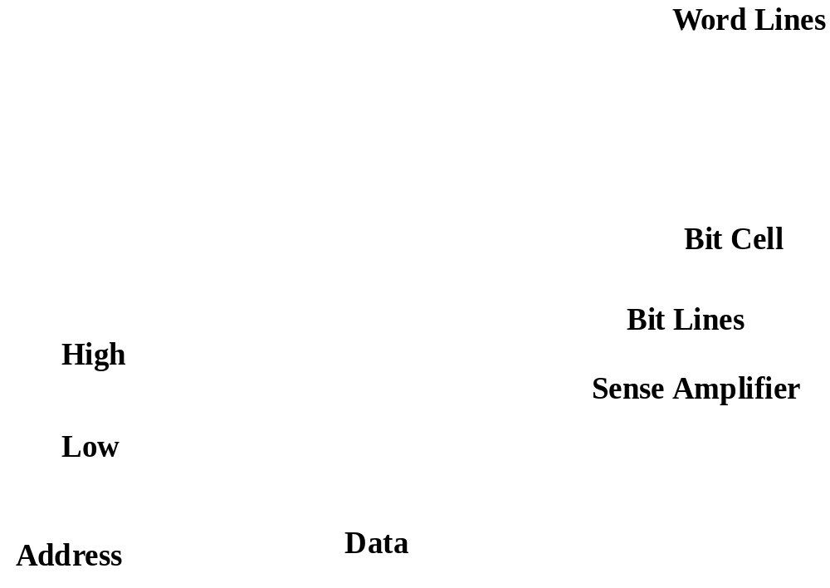
Basic RAM Architecture
Notes:
Magenta blocks can be thought of as any storage medium: ferro-magnetic, capacitive, even chemical (molecular) or atomic (excited electron state).

Slide 6
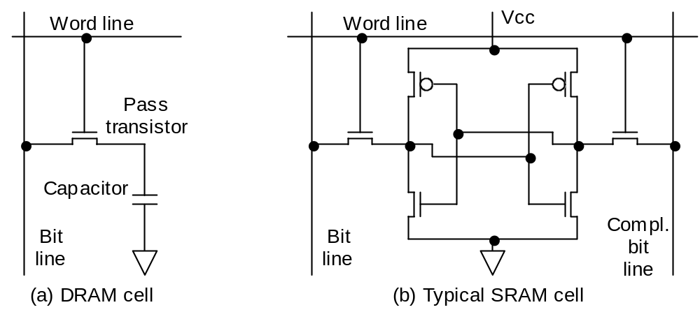
Memory Bit Cell
(Inside Pink Boxes of previous slide)
DRAM vs. SRAM Memory Cell Complexity
Single-transistor DRAM cell, which is considerably simpler than SRAM cell, leads to dense, high-capacity DRAM memory chips.

Slide 7
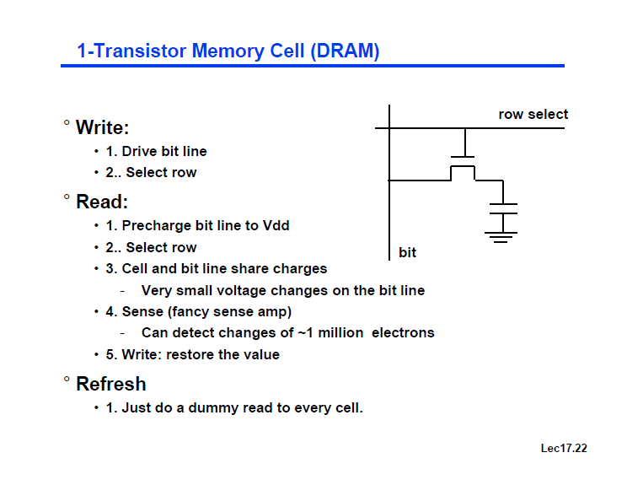

Slide 8
DRAM
DRAM value is stored as a charge on a capacitor.
  A single transistor is used to access the stored charge.
  Capacitors lose charge after several milliseconds
  To keep a charge, must refresh the capacitor
  Single-chip memory controllers handle the refresh function independent of the CPU.
.
DRAM cells are smaller, thus DRAM are denser

Slide 9
DRAM
Refreshing
  Use a two-level decoding structure.
    Allows us to refresh an entire row at a time
  Refresh typically consumes 1% to 2% of the active cycles of the DRAM.

Slide 10
RAM contd..
Main Memory uses DRAM for size (density)
  High density (1 transistor cells), low power, cheap, slow
  Dynamic: needs to be “refreshed” regularly (~ every 8 ms)
    1% to 2% of the active cycles of the DRAM
Notes:
Size comparison: DRAM/SRAM is 4 to 8 times
Cost/cycle time comparison SRAM/DRAM is 8 to 16 times
Need output enable on SRAM because outputs are tri-stated (0, 1, high impedance)

Slide 11
SRAM
21
Address
Chip select
SRAM
2M x 16
16
Output enable
Dout[15-0]
Write enable
Din[15-0]
16
Caches use SRAM for speed and technology compatibility
  Low density (6 transistor cells), high power, expensive, fast
  Static: content will last “forever” (until power turned off)

Slide 12

Accessing a Static RAM
Note: CE signal is often active-low as opposed to how shown here. SRAMs also generally have a write enable signal
9/22/2005
Lecture 9
Notes:
Note delay on the left, and comment on source.

Slide 13
Memory Subsystem
2 Types of Memory:
  ROM : Read Only Memory
    Program that is loaded into memory and cannot be changed. Also retains its data even without power.
  RAM : Random Access Memory
    Also called read/write memory. This type of memory can have a program loaded and then reloaded. It loses its data with no power.

Slide 14
ROM Chip(Memory)
Read Only Memory (ROM)
    Once programmed, cannot be changed
    Used as lookup tables to implement functions
    Used in PCs to store basic input/output systems (BIOS)
    Nonvolatile: keeps value when power is removed

Slide 15
Different ROM Chips
Masked ROM :
    ROM that is programmed with data when fabricated. Data will not change once installed. Hardwired.
Programmable ROM (PROM) :
    Capable of being programmed by the user with a ROM programmer. Not hardwired.
Erasable PROM (EPROM) :
    Much like the PROM this EPROM can be programmed and then erased by light.
EEPROM :
    Another form of EPROM but is reprogammable electrically.(Electrically erasable PROM)

Slide 16
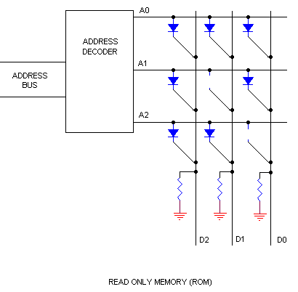
ROM
Data is stored in a ROM by breaking or preserving connections
  using a diode, transistor or fuses
0 0 0
0 1 0
0 0 1

Slide 17
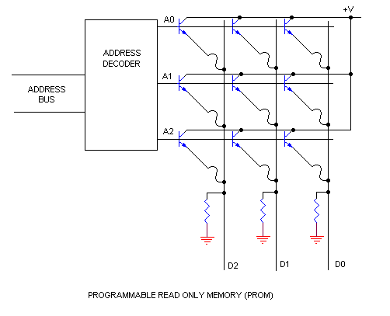
PROM
PROMs can only be programmed once
They are more fragile than ROMs
  a jolt of static electricity can cause fuses in the PROM to burn out, changing bits from 1 to 0
Blank PROMs are inexpensive and are good for prototyping the data for a ROM before committing to the costly ROM fabrication process.

Slide 18
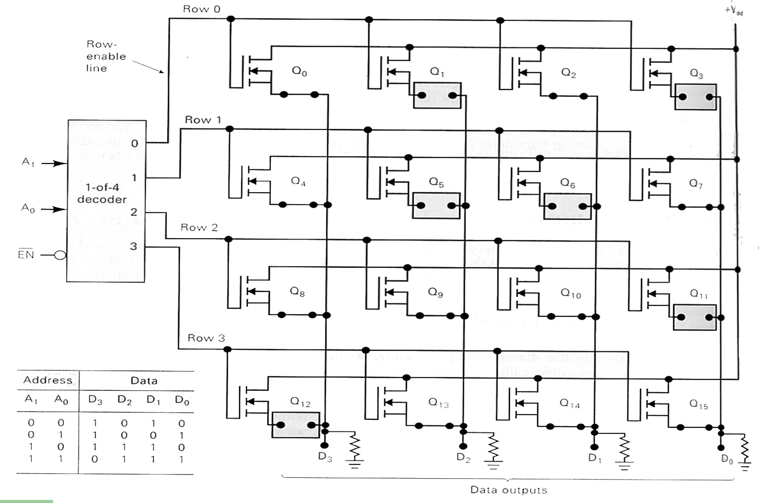
PROM
A closer look

Slide 19
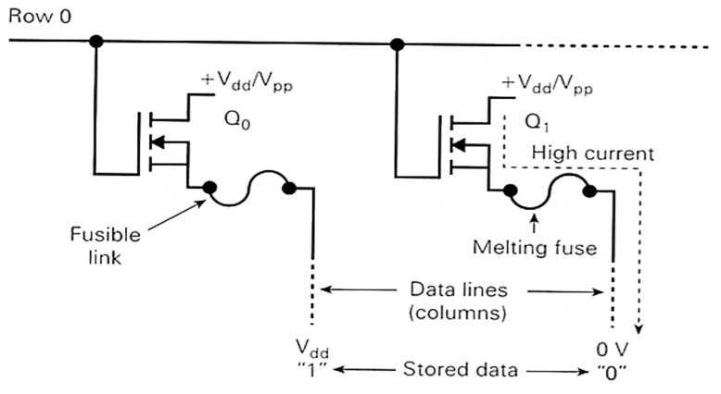
PROM
Programming the PROM is accomplished by passing a high current through a specific transistor and melting the fuse
  One-time programmable

Slide 20
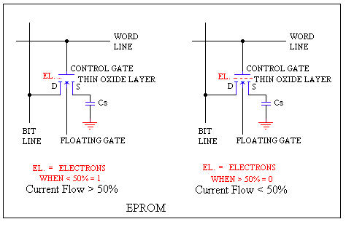
EPROM
An EPROM eraser is not selective, it will erase the entire EPROM.
The EPROM must be removed from the device it is in and placed under the UV light of the EPROM eraser for several minutes.
An EPROM that is left under UV light too long can become over-erased.
  In such a case, the EPROM's floating gates are charged to the point that they are unable to hold the electrons at all.

Slide 21
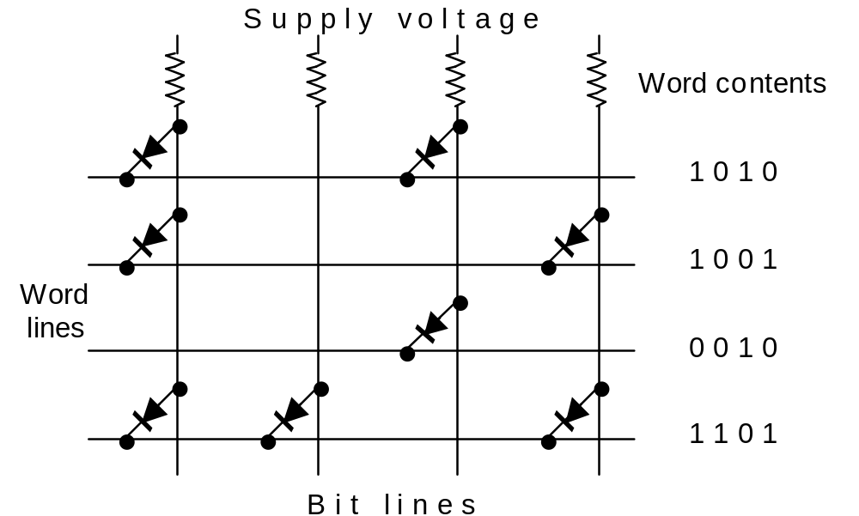
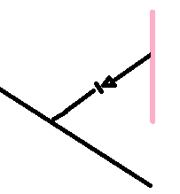
17.5 Nonvolatile Memory
ROM PROM EPROM

Slide 22
Increasing Size of Memory
Using Chips
Memory subsystem is the combination of memory chips
Example : 8 x 2 chips can be combined to make an 8 x 4 memory.
Both chips will receive the same 3 address inputs from the bus, as well as the CE and OE signals.
The data pins of the first chip are connected to bits 3 and 2 and the other to 1 an 0 of the data bus

Slide 23
Memory Subsystem Cont.
When the CPU reads data it places the address on the address bus.
Both chips will read in bits A1, A2, and A0 and decode
Since both chips are using the same CE and OE either both chips are active or not.
To the CPU it will act just like an 8 x 4 memory chip.

Slide 24

Memory Location Extension: Another Example
Memory Connection to CPU
Illustrates the use of both RAM and ROM in the same memory space
Shows the utility of chip-select inputs
Shows creative use of address lines
Address bus
CPU
16-11
10
9
8
7-1
RD
WR
Data bus
Decoder
3
2
1
0
CS1
CS2
128 x 8
RD
RAM 1
Data
WR
AD7
CS1
CS2
128 x 8
RD
RAM 2
Data
WR
AD7
CS1
CS2
128 x 8
Data
RD
RAM 3
WR
AD7
CS1
CS2
128 x 8
Morris M. Mano :- 12.2
Figure 12.4 on page 455
memory address map and
memory connection to CPU
RD
RAM 4
Data
WR
AD7
CS1
1- 7
CS2
512 x 8
8
ROM
Data
9
AD9

Slide 25
Memory Address Map for Microcomputer
 |  | Address Bus
Component | Hexadecimal Addr | 10 | 9 | 8 | 7 | 6 | 5 | 4 | 3 | 2 | 1
RAM1 | 0000-007F | 0 | 0 | 0 | x | x | x | x | x | x | x
RAM2 | 0080-00FF | 0 | 0 | 1 | x | x | x | x | x | x | x
RAM3 | 0100-017F | 0 | 1 | 0 | x | x | x | x | x | x | x
RAM4 | 0180-01FF | 0 | 1 | 1 | x | x | x | x | x | x | x
ROM | 0200-03FF | 1 | x | x | x | x | x | x | x | x | x
Morris M. Mano :- 12.2 Table 12.1memory address map for microcomputer
using Hexadecimal address

